Slide 1

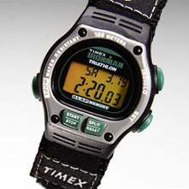
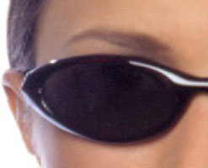
Chapter 44
Wave Optics(3)
Polarization (偏振)
y
TA
45^{ο}
x
E
fast
UP
slow
E_{s}
λ/4
z
E_{f}
RCP

Slide 2
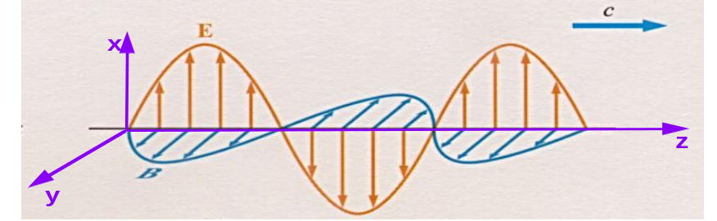
Radiation from oscillating dipole
+
+
V(t)=V_{o}cos(ωt)
-
-
Wave propagates outward at speed of light

Slide 3
Demonstrate transmitting and receiving of E-M radiation
broadcasting antenna
receiving antenna
+
+
oscilloscope
.......
+
-
-
-
Broadcasting antenna transmits e-m wave at 200 MHz
- linearly polarized
Receiving antenna also tuned to 200 MHz
- also linearly polarized
- signal displayed on fast oscilloscope screen
- demonstrate polarization sensitivity

Slide 4
44-1 Linear Polarization (线偏振)
How else can we produce linearly polarized (LP) e-m waves?
  Absorp./reflect. of vector component of wave perp to “polarizer”
TA
(transmission axis)
LP
microwave
source
slotted
metal
plate
(polarized)
The E-field component parallel to the slots is absorbed and/or reflected.
The E-field component perpendicular to the slots is transmitted.
    Polaroid （偏振片）(sunglasses)
Long molecules absorb E-field parallel to molecule.
TA
(transmission axis)
Absorption produces LP e-m waves but in so doing it also reduces intensity of the wave. How much??

Slide 5




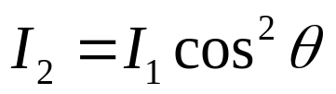

LP Intensity Reduction
TA
UP
(unpolarized light)
E₁
θ
TA
I=I₀
θ
I₁=??
E₂
LP
LP
I₂=??
This set of two linear polarizers produces LP light. What is the final intensity?
  First LP transmits 1/2 of the unpolarized light: I₁ = 1/2 I₀
  Second LP projects out the E-field component parallel to the TA:
This result is called the Law of Malus (for LP light incident on LP)

Slide 6
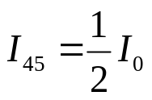
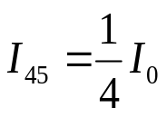




Chapter 44, ACT 1
Light of intensity I₀, polarized along the x direction is incident on a set of 2 linear polarizers as shown.
  Assuming θ = 45°, what is I₄₅,
  the intensity at the exit of the 2 polarizers, in terms of I₀?
x
TA
E
θ
0
y
1A
I=I
TA
0
z
I
=?
(a)
45
(b)
(c)
1B
What is the relation between I₄₅ and I₃₀, the final intensities in the situation above when the angle θ = 45° and 30°, respectively?
(a)
(b)
(c)
x
TA
x
30
TA
E
45
E
0
0
y
TA
y
I=I
I=I
TA
0
0
I
z
z
=?
I
=?
45
30

Slide 7


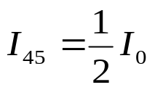
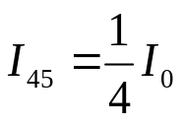


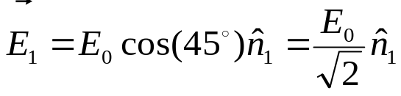

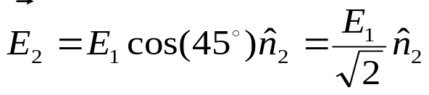
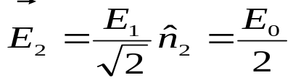
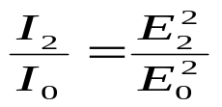
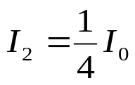
Chapter 44, ACT 1
Light of intensity I₀, polarized along the x direction is incident on a set of 2 linear polarizers as shown.
  Assuming θ = 45°, what is the relation between the I₄₅, the intensity at the exit of the 2 polarizers, in terms of I₀?
x
TA
E
θ
0
E₁
y
1A
I=I
TA
0
E₂
z
I
=?
(a)
45
(b)
(c)
We proceed through each polarizer in turn.
  The electric field following the first polarizer is:
  Therefore,
The electric field following the second polarizer is:
Therefore,
Putting together,

Slide 8
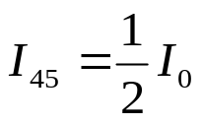





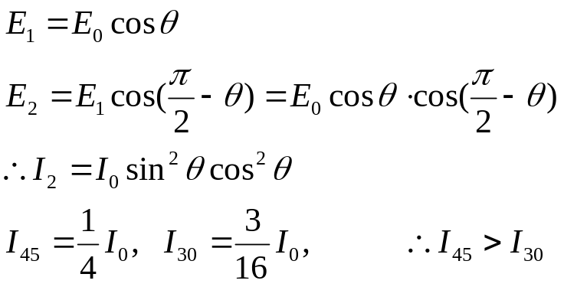
Chapter 44, ACT 1
Light of intensity I₀, polarized along the x direction is incident on a set of 2 linear polarizers as shown.
  Assuming θ = 45°, what is the relation between the I₄₅, the intensity at the exit of the 2 polarizers, in terms of I₀?
x
TA
E
θ
0
E₁
y
1A
I=I
TA
0
E₂
z
I
=?
(a)
45
(b)
(c)
1B
What is the relation between I₄₅ and I₃₀ , the final intensities in the situation above when the angle θ = 45° and 30°, respectively?
(a)
(b)
(c)

Slide 9






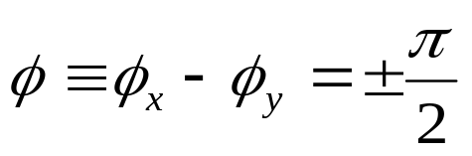
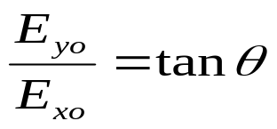

44-2 Other Polarization States?
Are there polarizations other than linear?
  Sure!!
  The general harmonic solution for a plane wave traveling in the +z-direction is:
y
y
θ
x
x
Linear
Polarization
Circular
Polarization

Slide 10




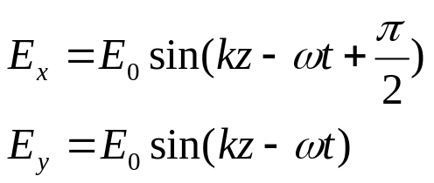
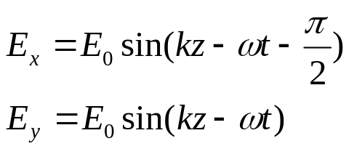
Circular Polarization (园偏振光)
( and are ±90° out of phase.)
- Right(右)-handed (RCP)
  Electric field spirals CW in space (at fixed time)
- Left(左)-handed (LCP)
  Electric field spirals CCW in space (at fixed time)
y
y
x
x
RCP = CW
LCP = CCW

Slide 11
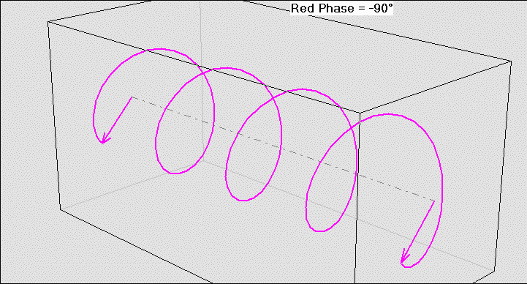
Visualization
Why do we call this circular polarization?
Note: If you shine circularly polarized light onto an absorber, it will in principle start to rotate → conservation of angular momentum!

Slide 12
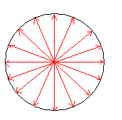
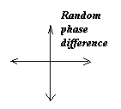
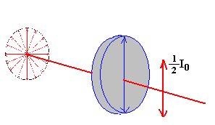
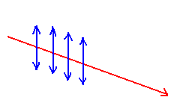
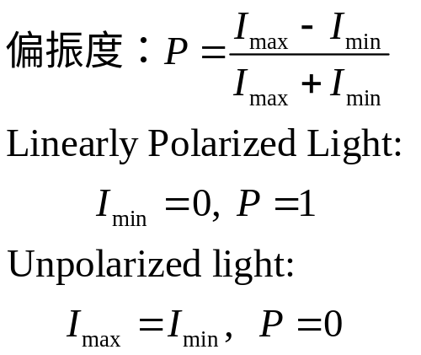
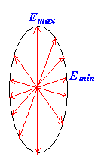

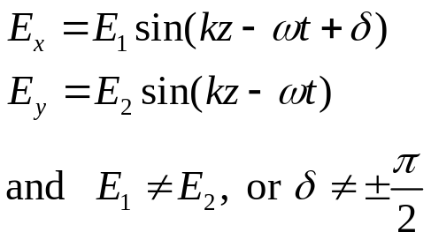
There are 5 kinds Polarization States
Unpolarized Light (无偏振光, 自然光)
Linearly Polarized light(线偏振光)
Partial Polarized light (部分偏振光)
Circular Polarized light(圆偏振光)
Ellipse Polarized light(椭圆偏振光)

Slide 13
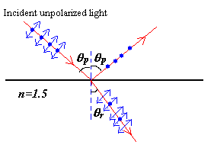
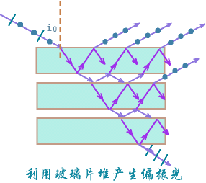
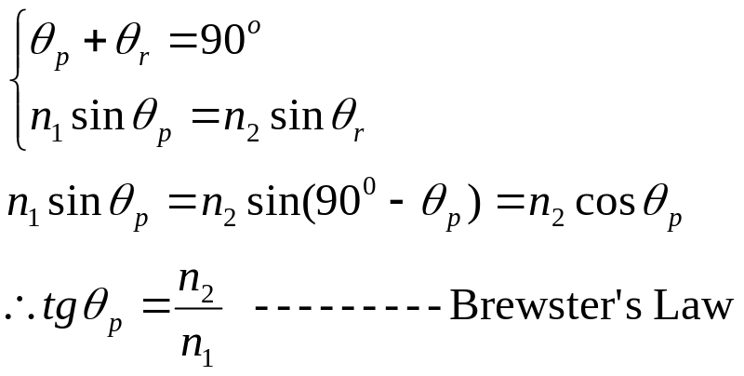

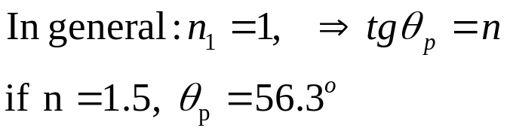
44-3 Polarization by Reflection
For glass or other dielectric materials, there is a particular angle of incidence.
Brewster’s angle: (布儒斯特角)
Stack of glass plates

Slide 14
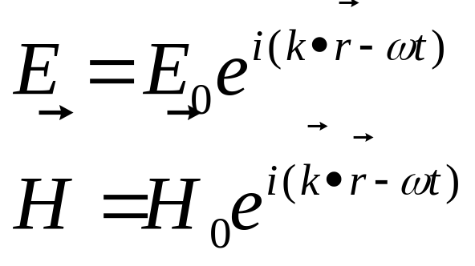
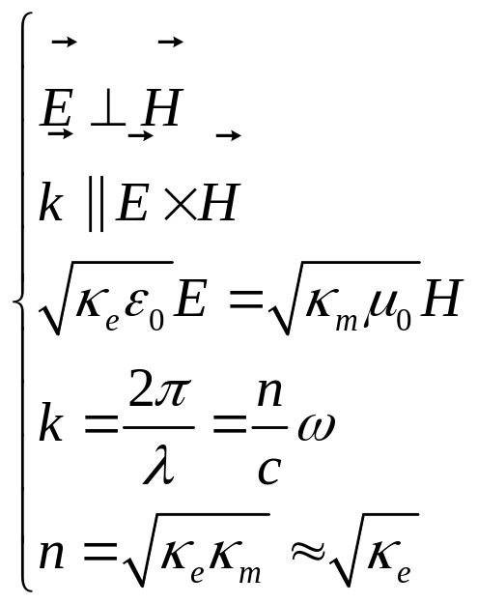
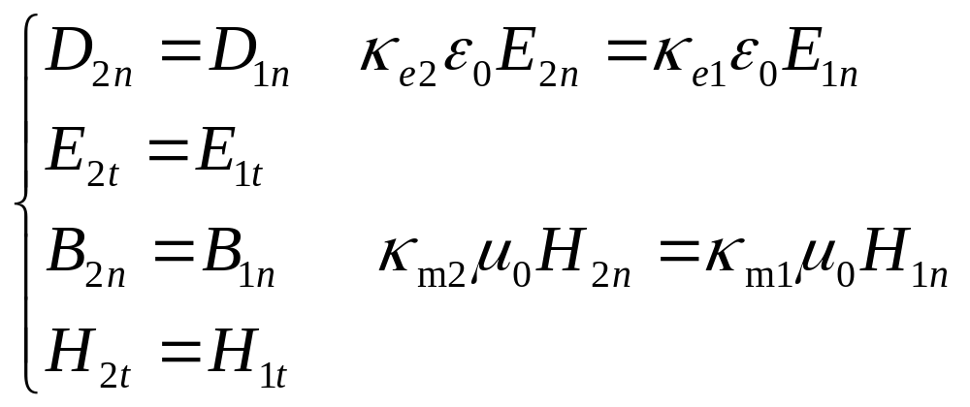
Notes: From Maxwell’s Equations
Brewster’s angle;
Phase change on Reflection

Slide 15
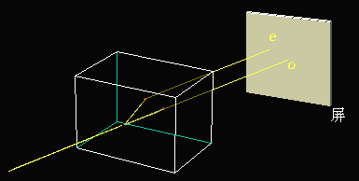
44-4 Birefringence (双折射)
Optical anisotropy of crystalline solids
Calcite (CaCO₃)
Screen
Ordinary light (寻常光)—single index of refraction
Extraordinary light (非寻常光)—the index of refraction varies with direction of light

Slide 16
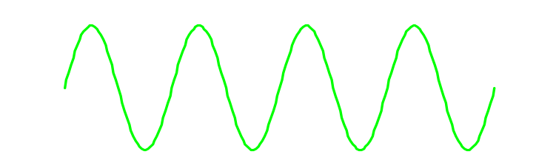
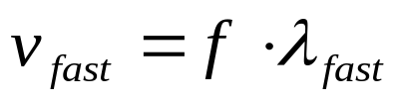

Explanation
-----Birefringence (双折射)
Birefringent materials (crystals or stressed plastics) have the property that the speed of light is different in the two transverse dimensions.
Since the frequency of the wave must remain constant as the wave passes through the birefringent material, the wavelength must be different in the two dimensions, which allows for a phase change.
Fast Axis:
λ_{fast}
λ_{slow} < λ_{fast}
The relative phase change (fast vs slow) is determined by the thickness
Slow Axis:
λ_{slow}

Slide 17
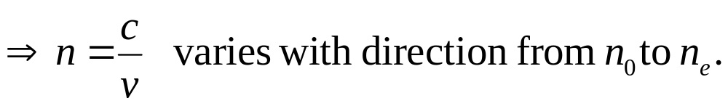
Explanation (Con.)
The o-ray travels in the crystal with the same speed v₀ in all directions.
--------- a single index of refraction n₀.
The e-ray travels in the crystal with a speed that varies with the direction from v₀ to v_{e}.
n_{o,} n_{e}: The principle indices of refraction.
(主折射率)

Slide 18
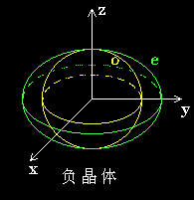
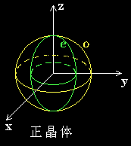
Explanation (Con.)
Optic
axis
Optic
axis
S
S
Negative Crystal
Positive Crystal
CaCO₃ (方解石)
v_{e}>v_{o}，n_{e}<n_{o}
负晶体
SiO₂ (石英，水晶)
v_{e}<v_{o}，n_{e}>n_{o}
正晶体

Slide 19
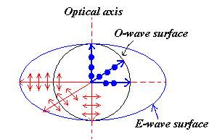
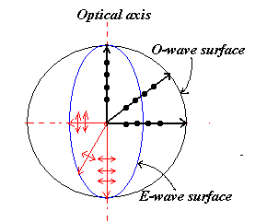
Explanation (Con.) 光轴的概念
CaCO₃ (方解石)
v_{e}>v_{o}，n_{e}<n_{o}
负晶体
SiO₂ (石英，水晶)
v_{e}<v_{o}，n_{e}>n_{o}
正晶体

Slide 20
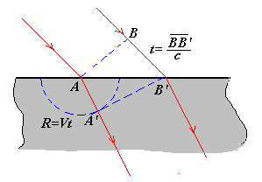
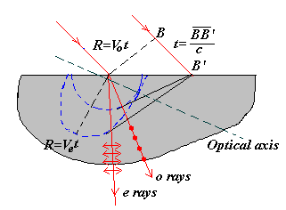
Birefringence (双折射)
Isotropy (各向同性) Crystal
Anisotropy (各向异性) Crystal

Slide 21
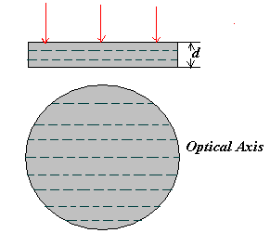
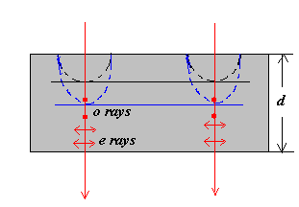


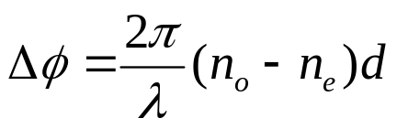
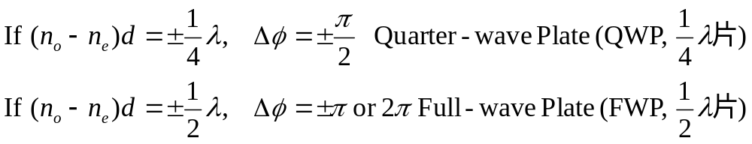
Wave Plates (波片)
O-rays optical path:
E-rays optical path:
The difference of phase:

Slide 22
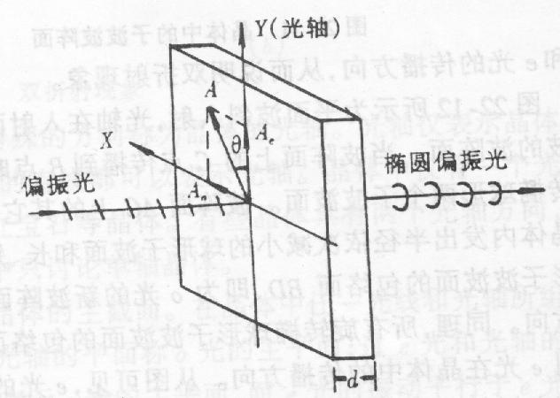
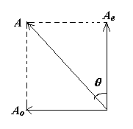


How to distinguish between circularly polarized and unpolarized?
x (optic axis)
Elliptical
polarization
Linearly
polarized

Slide 23





Example: Wave Plates (波片)
Birefringent crystals with precise thicknesses
Ex.: Crystal which produces a phase change of π/2 → “quarter wave plate” (a “full wave plate” produces a relative shift of → no effect).
Light polarized along the fast or slow axis merely travels through at the appropriate speed → polarization is unchanged.
Light linearly polarized at 45° to the fast or flow axis will acquire a relative phase shift between these two components → alter the state of polarization.
The phase of the component along the fast axis advances π/2 less than the phase of the component along the slow axis. E.g.,
Passage through QWP:
α ≡ kz -ωt
α _{slow} → α _{slow}
α _{fast} → α _{fast} - π/2
Before
QWP
RCP
After
QWP
Quarter Wave Plate → circular polarization

Slide 24





Quarter Wave Plates
Light linearly polarized at 45º incident on a quarter wave plate produces the following wave after the quarter wave plate:
Fast axis:
Slow axis:
Rotation at t=0:
Max vectors at t=0:
y
y
TA
45^{ο}
x
E
fast
UP
x
slow
E_{s}
λ/4
RCP = CW
z
E_{f}
RCP
QWP: slow (no change), fast (ahead λ/4)

Slide 25







Chapter 44, ACT 2
Light of intensity I₀, polarized along the x direction is incident on a quarter-wave plate (fast axis= y-axis) and a linear polarizer as shown.
  What is the relation between I₁, the intensity at the exit of the system, in terms of I₀?
x
E
s
0
y
f
I=I
TA
3A
0
z
I
=??
1
(a)
(b)
(c)
x
E
θ
f
What is the relation between I₂, the final intensity when the fast axis makes an angle θ = 45° with the x-axis, in terms of I₀?
0
s
3B
y
I=I
TA
0
z
(a)
(b)
(c)
I
=??
2

Slide 26



Chapter 44, ACT 2
Light of intensity I₀, polarized along the x direction is incident on a quarter-wave plate (fast axis= y-axis) and a linear polarizer as shown.
  What is the relation between I₁, the intensity at the exit of the system, in terms of I₀?
x
E
s
0
y
f
I=I
TA
3A
0
z
I
=??
1
(a)
(b)
(c)
The quarter wave plate aligned with the initial axis of polarization will not change the polarization of the wave at all!!!
The next polarizer, being at right angles, will eliminate the wave completely!

Slide 27





Chapter 44, ACT 2
Light of intensity I₀, polarized along the x direction is incident on a quarter-wave plate (fast axis= y-axis) and a linear polarizer as shown.
  What is the relation between I₁, the intensity at the exit of the system, in terms of I₀?
x
E
s
0
y
f
I=I
TA
3A
0
z
I
=??
1
(a)
(b)
(c)
x
E
θ
f
What is I₂, the final intensity when the fast axis makes an angle θ = 45° with the x-axis, in terms of I₀?
0
s
3B
y
I=I
TA
0
z
(a)
(b)
(c)
I
=??
2
The quarter wave plate produces circularly polarized light.
The fast and slow components are attenuated independently since they are out of phase!
fast
slow

Slide 28


What Causes Birefringence?
Birefringence can occur in any material that possesses some asymmetry in its structure, so that the material is more “springy” in one direction than another.
Examples: Crystals: quartz, calcite
Different atom spacings in and .
Long stretched molecular chains: saran wrap, cellophane tape

Slide 29



Birefringence, cont.
Oblong molecules: “liquid crystals”
Dipoles of the molecules orient along an externally applied electric field. Change the field → change the birefringence → change the polarization of transmitted light → pass through polarization analyzer to change the intensity
→ Digital displays, LCD monitors, etc.
Stress-induced birefringence:
Applying a mechanical stress to a material will often produce an asymmetry → birefringence.
This is commonly used to measure stress.

Slide 30

A Really Cool Application: Light-Driven Micro Machines
(April 2002!)
Fact 1: Small particles are attracted to regions of high E field gradient (induced dipole force) → laser “tweezers”
Fact 2: Because birefringent crystals convert
linear ↔ circular polarization, they acquire angular momentum → rotation
Parts are only 10μm across!
Uses: Biophysics: Manipulating DNA, proteins, etc.
Microscopic fluid pumps

Slide 31

Summary
Linear Polarizers
  Law of Malus
Circular Polarization
  Quarter-Wave Plate
Unpolarized
light
45^{ο}
TA
E
fast
y
x
slow
z

Slide 32
Unpolarized Light
We have primarily been considering light that has a definite polarization (e.g., linear or circular). Most sources – a candle, the sun, any light bulb – produce light that is unpolarized :
  it does not have a definite direction of the electric field
  there is no definite phase between orthogonal components
  the atomic or molecular dipoles that emit the light are randomly oriented in the source
  the intensity of light transmitted through a polarizer is always half the intensity of the unpolarized input, regardless of the orientation of the polarizer
  (though of course the output is polarized!)
  These are all equivalent ways of describing the same thing.

Slide 33

44-5 Polarization by Scattering
Suppose unpolarized light encounters an atom and scatters (energy absorbed & reradiated).
  What happens to the polarization of the scattered light?
  The scattered light is preferentially polarized perpendicular to the plane of the scattering.
    For example, assume the incident unpolarized light is moving in the z-direction.
    Scattered light observed along the x-direction (scattering plane = x-z) will be polarized along the y-direction.
    Scattered light observed along the y-direction (scattering plane = y-z) will be polarized along the x-direction.
y
This box contains atoms which “scatter” the light beam
x
z

Slide 34


Applications
Sunglasses
  The reflection off a horizontal surface (e.g., water, the hood of a car, etc.) is strongly polarized. Which way?
  A perpendicular polarizer can preferentially reduce this glare.
Polarized sky
  The same argument applies to light scattered off the sky:

Slide 35
Why is that?
Maximum intensity
In many cases light is radiated/scattered by oscillating electric dipoles.
+
Intensity lobe
–
Less intensity
No radiation along direction of motion!
Start with sunlight with all polarizations & randomly oriented dipoles.
2 cases:
+
±
–
Dipole oscillates into the paper.
Horizontal dipoles reradiate H­polarized light downward.
(Do not respond to incident V­light.)
Dipole oscillates vertically.
Vertical dipoles reradiate V-polarized light to the sides (not downward).
(Do not respond to incident H­light.)

Slide 36
Homework
Page 1012 Exercises 5, 8, 14, 15
Page 1013 Problems, 4, 6

